Slide 1


Slide 2
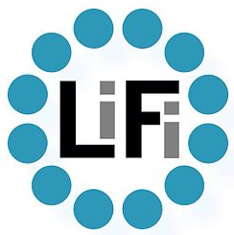
WHAT IS LIFI?
Li-Fi short for light fidelity) is a technology for wireless communication between devices using light to transmit data and position. In its present state only LED lamps can be used for the transmission of visible light. In technical terms, Li-Fi is a visible light communications system that is capable of transmitting data at high speeds over the visible light spectrum, ultraviolet and infrared radiation.

Slide 3
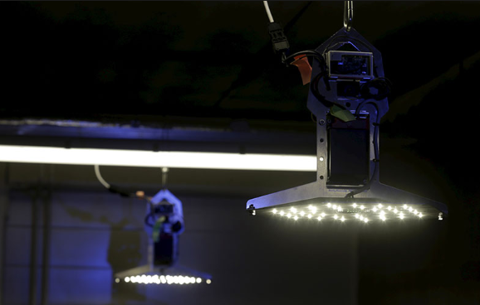
LI FI IN TERMS OF BINARY
The visible light has a spectrum 10,000 times larger than radio waves. This means LIFI has the potential for enormous capacity. LIFI works by flashing LED lights on or off at incredibly fast speeds, sending data to a receiver in BINARY CODE.

Slide 4
ADVANTAGES OF LIFI
EFFICIENCY: Li-Fi works on visible light technology. Since homes and offices already have LED bulbs for lighting purposes, the same source of light can be used to transmit data. Hence, it is very efficient in terms of costs as well as energy. Light must be on to transmit data, so when there is no need for light, it can be reduced to a point where it appears off to human eye, but is actually still on and working.
AVAILABILITY: Wherever there is a light source, there can be Internet. Light bulbs are present everywhere – in homes, offices, shops, malls and even planes, meaning that high-speed data transmission could be available everywhere.
SECURITY: One main advantage of Li-Fi is security. Since light cannot pass through opaque structures, Li-Fi Internet is available only to the users within a room and cannot be breached by users in other rooms or buildings.

Slide 5
DISADVANTAGES OF LIFI
Internet cannot be used without a light source. This could limit the locations and situations in which Li-Fi could be used.
Because it uses visible light, and light cannot penetrate walls, the signal's range is limited by physical barriers.
Other sources of light may interfere with the signal. One of the biggest potential drawbacks is the interception of signals outdoors. Sunlight will interfere the signals, resulting in interrupted Internet.
A whole new infrastructure for Li-Fi would need to be constructed.

Slide 6
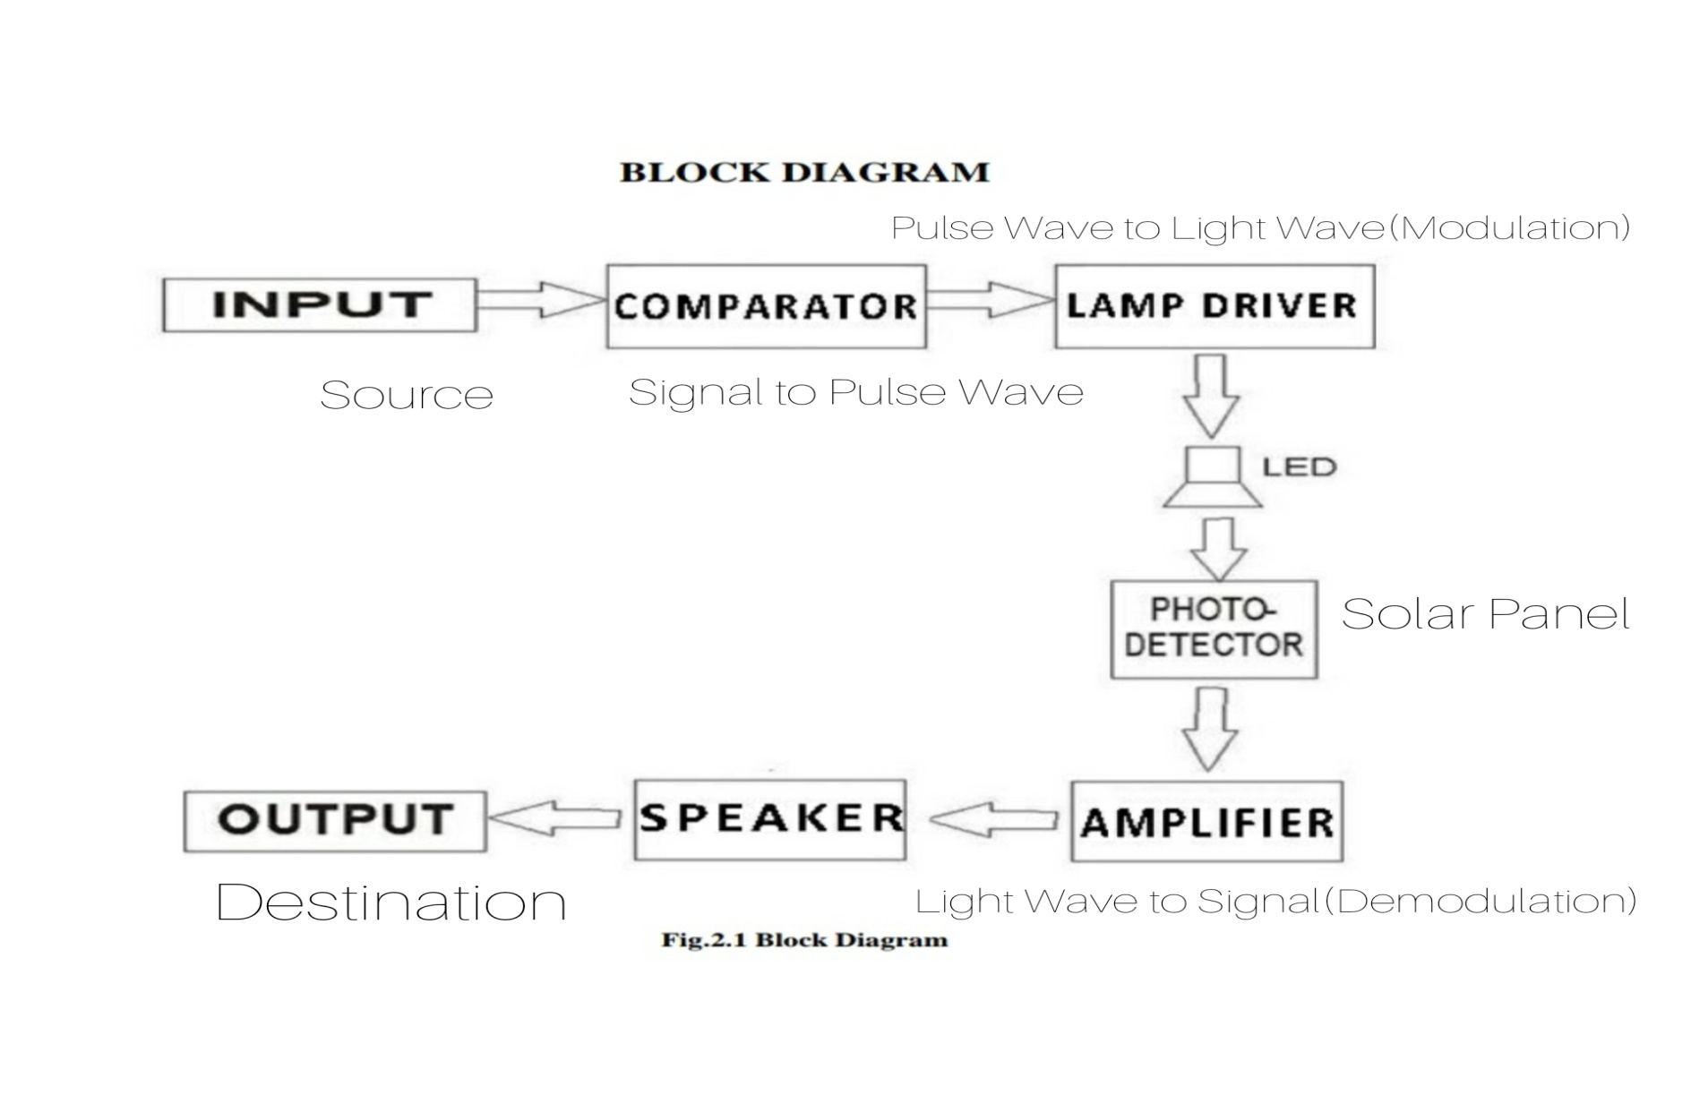
WORKING OF LIFI

Slide 7
REFLECTION
Reflection is the change in direction of a wavefront at an interface between two different media so that the wavefront returns into the medium from which it originated. Common examples include the reflection of light, sound and water waves. The law of reflection says that for specular reflection the angle at which the wave is incident on the surface equals the angle at which it is reflected. Mirrors exhibit specular reflection.

Slide 8
APPLICATIONS
Normal tube lights can be used for communication reducing modem costs.
It can be used for inter-departmental communication and can be made more faster.
Street lights with Hotspot Stands and can be extended to many important highways and used to generate revenue for Government.

Slide 9
FORETHOUGHT
To study the reflecting properties of aluminium foil to reduce the making cost
To change some internal components to transmit other types of data(than music) like photos,videos,text using respective input,output devices.
To install a microcontroller (like Arduino) to control the features more efficiently

Slide 10
THANK YOU!!!
DONE BY :
S . K . HARI KHESHAV
V . INDHUMATHI
G . JERUSHA

